Slide 1


Higher Institute of Technological Studies of Tataouine
End of Studies Project
Amel Khalissa
Project Builder
Medical Laboratory Web Application Management
Presentation of Architecture, Conceptual Study and Realization of the Project
Supervised by: Mrs Dalel Bourkhis

Slide 2

PLAN
Architecture and life cycle
Analyses and
Conceptual Study
Realization
Conclusion

Slide 3
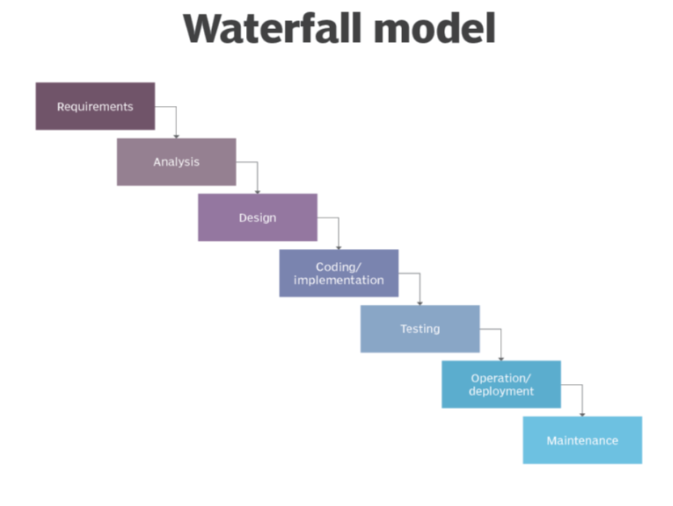
Architecture and Life Cycle

Slide 4
Existing Systems Critics
01
02
03
04
Lack of simplicity
Waiting Time Waste
Difficult search
Insecurity

Slide 5


Proposed Solution
Laboratory Management
On devices
Distant Server
Symfony Framework
Secure and easy

Slide 6
Functional Requirements
The patient consults his results
04
They can access from anywhere
03
02
The workers manage their tasks
Laboratory Management
01

Slide 7

Non-functional Requirements
Secure
Easy
1
2
3
4
Supportable
Specific

Slide 8
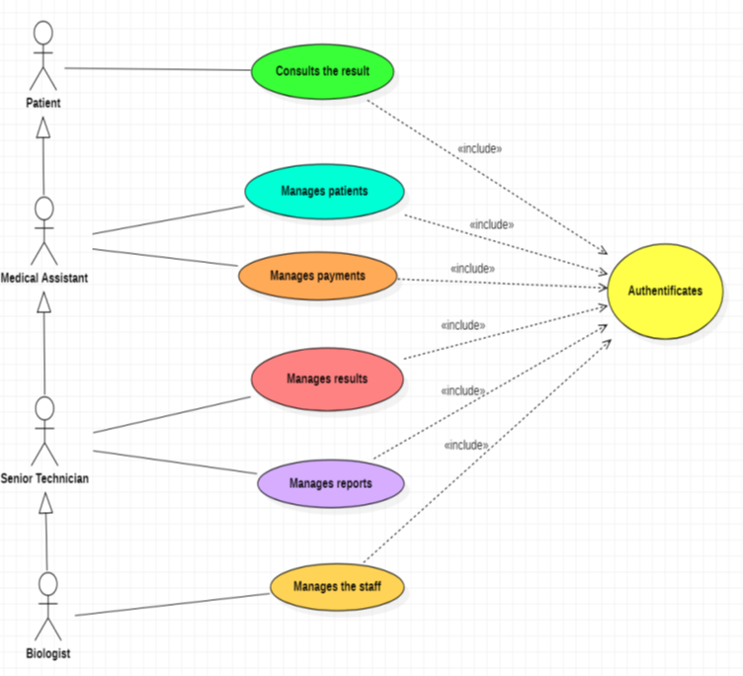
Use Cases
General Use Case

Slide 9
Use Cases
Manage the Staff Use Case

Slide 10
Use Cases
Manage the Results Use Case

Slide 11
Use Cases
Manage the Reports Use Case

Slide 12
Use Cases
Manage Payments Use Case

Slide 13
Use Cases
Manage Patients Use Case

Slide 14
Use Cases
Authenticate Use Case

Slide 15
Class Diagram
Title Goes Here There are many variations of passages but the majority have suffered alteration in some form by injected are many variations of .

Slide 16
Sequence Diagrams
Authentication Sequence Diagram

Slide 17
Sequence Diagrams
Add Result Sequence Diagram

Slide 18
Sequence Diagrams
Delete User Sequence Diagram

Slide 19
Sequence Diagrams
Update Report Sequence Diagram

Slide 20
Sequence Diagrams
Consult Patient Sequence Diagram

Slide 21
Activity Diagrams
General Activity Diagram (Admin)

Slide 22
Activity Diagrams
Add User
Delete Report
Update Result
Consult Patient

Slide 23
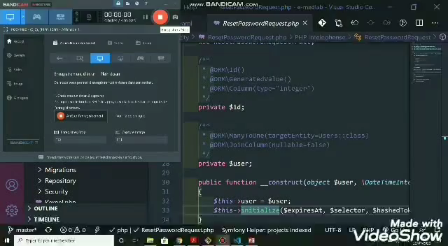


Realization

Slide 24
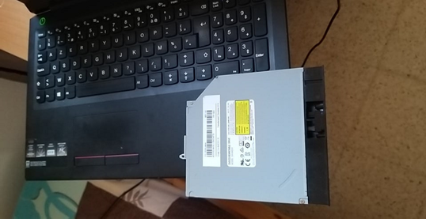
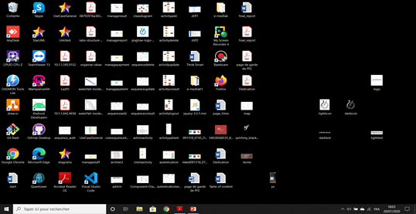
Difficulties
The absence of a development Supervisor
The current situation in the country and the world
Hardware and software problems

Slide 25
Conclusion
Discovering Documentations
Learning new skills
Improve my English
Very nice experience
Dealing with the project Alone

Slide 26

What is the future of this application
This web application can have a large future
Continue my master degree abroad
Web Hosting
Reformulating the application
This application can be reformulated for all medical management.
Building a mobile application

Slide 27
Thank you for your attention

